Slide 1
#3.1 tableone
library(dplyr)
rladies_global %>%
filter(city == ’Munich')
session == beginner

Slide 2

Hello!
I am Pam
Today I would like to share some tips with you on how to create easy tables using tableone
And introduce you to Slack – a platform to keep in touch with everyone in this room (and more people)

Slide 3
Reminder:
You can find everything used in this session if you drop by my repo
https://github.com/pamelamatias/RLadies_MUC
and either clone or download the files ☺

Slide 4
What is a “table one” anyway?

Slide 5
Base graphics
ggplot2
Images and code borrowed from a very nice Harvard tutorial

Slide 7
tableone examples
🎨
Code used for all of them is in our repo.
So if it’s rainy, you can run and have fun playing with it this weekend…

Slide 8
Dataset
Inside Airbnb

Slide 9
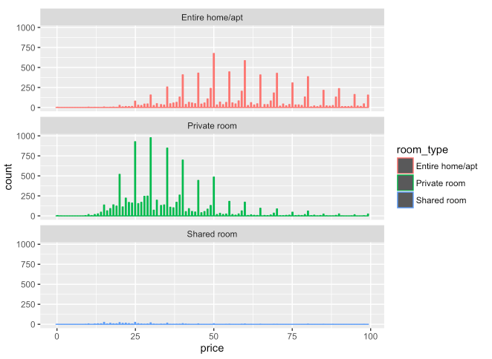
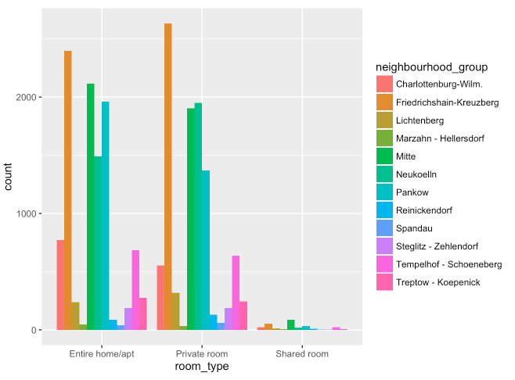
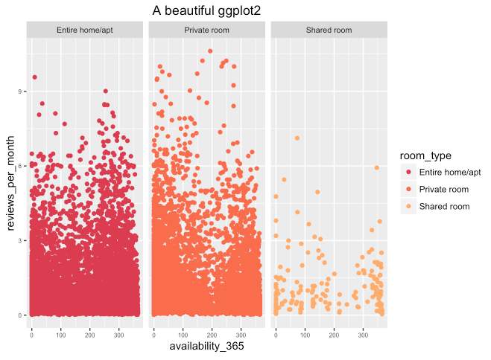
Some cool ggplot2s

Slide 10
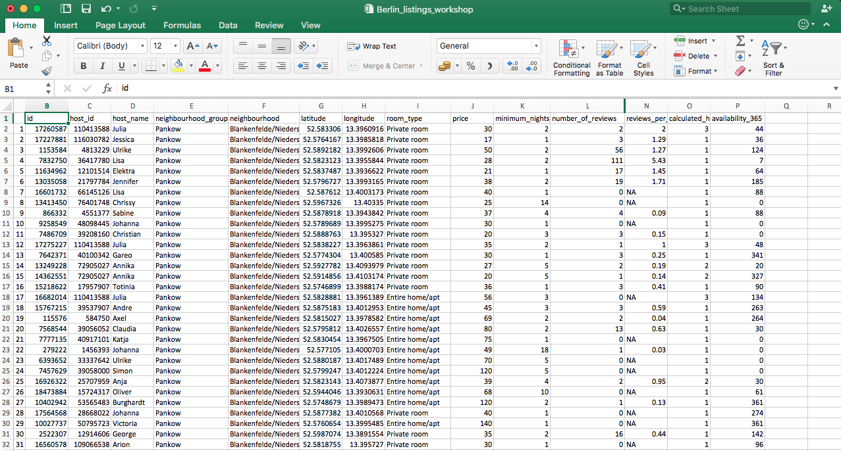
How does the dataset look like?
> head(berlin)

Slide 11
Define your variable types!
>
berlin$id <- as.integer(berlin$id)
berlin$host_id <- as.integer(berlin$host_id)
berlin$host_name <- as.factor(berlin$host_name)
berlin$neighbourhood_group <- as.factor(berlin$neighbourhood_group)
berlin$neighbourhood <- as.factor(berlin$neighbourhood)
berlin$room_type <- as.factor(berlin$room_type)
berlin$number_of_reviews <- as.numeric(berlin$number_of_reviews)
berlin$last_review <- as.Date(berlin$last_review)
berlin$calculated_host_listings_count <- as.numeric(berlin$calculated_host_listings_count)
berlin$availability_365 <- as.numeric(berlin$availability_365)
berlin$minimum_nights <- as.numeric(berlin$minimum_nights)
berlin$reviews_per_month <- as.numeric(berlin$reviews_per_month)
berlin$price <- as.numeric(berlin$price)

Slide 12
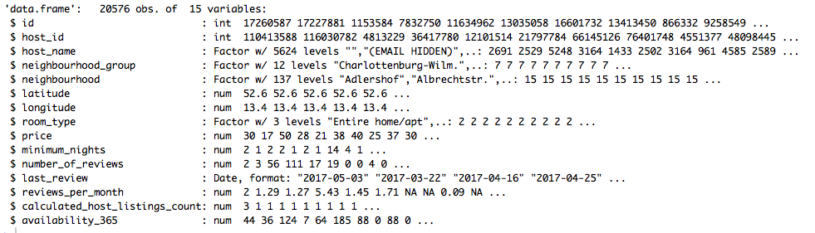
Check your variable types
> str(berlin)

Slide 13
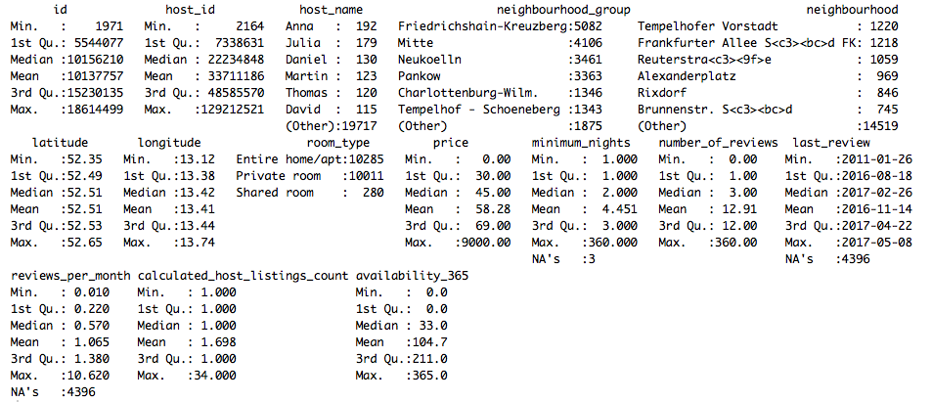
Getting something out of your data
> summary(berlin)

Slide 14
Table 1. General
listVar <-c("neighbourhood_group","room_type","price","minimum_nights","number_of_reviews","reviews_per_month","calculated_host_listings_count","availability_365")
table1 <- CreateTableOne (data = berlin,
vars = listVar)

Slide 15
Table 1. General
n | 20576
neighbourhood_group (%)
Charlottenburg-Wilm. | 1346 (6.5)
Friedrichshain-Kreuzberg | 5082 (24.7)
Lichtenberg | 568 (2.8)
Marzahn - Hellersdorf | 82 (0.4)
Mitte | 4106 (20.0)
Neukoelln | 3461 (16.8)
Pankow | 3363 (16.3)
Reinickendorf | 223 (1.1)
Spandau | 102 (0.5)
Steglitz - Zehlendorf | 375 (1.8)
Tempelhof - Schoeneberg | 1343 (6.5)
Treptow - Koepenick | 525 (2.6)
room_type (%)
Entire home/apt | 10285 (50.0)
Private room | 10011 (48.7)
Shared room | 280 (1.4)
price (mean (sd)) | 58.28 (88.30)
minimum_nights (mean (sd)) | 4.45 (10.83)
number_of_reviews (mean (sd)) | 12.91 (26.75)
reviews_per_month (mean (sd)) | 1.07 (1.30)
calculated_host_listings_count (mean (sd)) | 1.70 (2.84)
availability_365 (mean (sd)) | 104.71 (128.08)

Slide 16
Table 1.2 Comparing neighbourhoods
listVar_hood <- listVar[listVar!="neighbourhood_group"]
tabletable1_hoods <-
CreateTableOne(data = berlin,
vars = listVar_hood,
strata=c("neighbourhood_group"))

Slide 17
Table 1.2 Comparing neighbourhoods
 | Charlottenburg-Wilm. | Friedrich.-Kreuzberg | Lichtenberg | Marzahn - Hellersdorf | Mitte | Neukoelln
n | 1346 | 5082 | 568 | 82 | 4106 | 3461
room_type (%)
Entire home/apt | 772 (57.4) | 2396 (47.1) | 237 (41.7) | 46 (56.1) | 2114 (51.5) | 1491 (43.1)
Private room | 552 (41.0) | 2633 (51.8) | 317 (55.8) | 31 (37.8) | 1904 (46.4) | 1951 (56.4)
Shared room | 22 (1.6) | 53 (1.0) | 14 (2.5) | 5 (6.1) | 88 (2.1) | 19 (0.5)
price (mean (sd)) | 72.47 (256.84) | 56.70 (39.58) | 56.17 (214.47) | 51.85 (36.76) | 65.29 (67.79) | 45.80 (31.45)
minimum_nights (mean (sd)) | 7.02 (19.02) | 4.32 (9.92) | 3.40 (6.87) | 3.24 (7.10) | 4.42 (10.01) | 3.82 (7.84)
number_of_reviews (mean (sd)) | 12.52 (23.16) | 13.14 (26.05) | 8.76 (17.25) | 9.51 (13.66) | 16.42 (32.18) | 9.28 (20.49)
reviews_per_month (mean (sd)) | 1.19 (1.40) | 1.04 (1.26) | 1.19 (1.33) | 1.15 (1.24) | 1.34 (1.57) | 0.81 (1.08)
calculated_host_listings_count (mean (sd)) | 1.93 (2.75) | 1.61 (2.41) | 1.48 (1.73) | 1.43 (1.04) | 2.25 (4.43) | 1.33 (1.08)
availability_365 (mean (sd)) | 140.80 (133.58) | 91.64 (123.11) | 110.89 (132.40) | 221.37 (122.75) | 108.46 (127.55) | 79.78 (118.48)

Slide 18
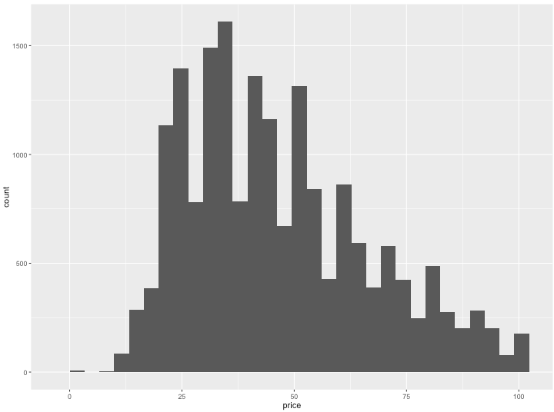
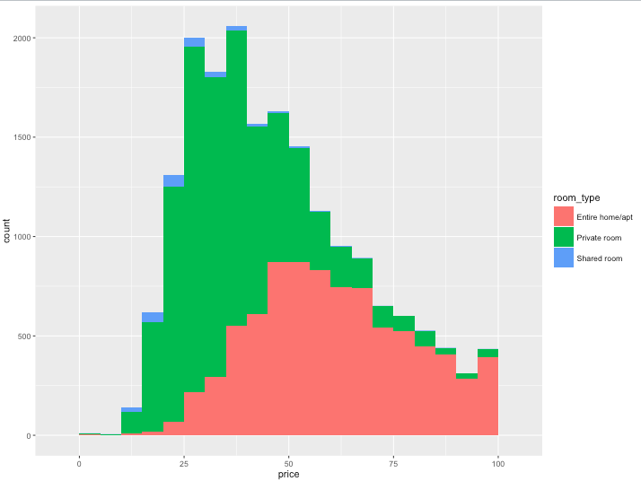
Table 1.3 Comparing room types and minding variable distributions
berlin_price <- subset(berlin,price<100)

Slide 19
Table 1.3 Comparing room types and minding variable distributions
var_nonnormal <- c("price")
table1_price <-
CreateTableOne( data = berlin_price,
vars = listVar[listVar!="room_type"],
strata = c("room_type"))

Slide 20
Table 1.3 Comparing room types and minding variable distributions
 | Entire home/apt | Private room | Shared room | p | test
n | 8432 | 9850 | 270
neighbourhood_group (%) |  |  |  | <0.001
Charlottenburg-Wilm. | 621 (7.4) | 535 (5.4) | 22 (8.1)
Friedrichshain-Kreuzberg | 1942 (23.0) | 2599 (26.4) | 50 (18.5)
Lichtenberg | 218 (2.6) | 311 (3.2) | 13 (4.8)
Marzahn - Hellersdorf | 36 (0.4) | 31 (0.3) | 5 (1.9)
Mitte | 1578 (18.7) | 1856 (18.8) | 88 (32.6)
Neukoelln | 1377 (16.3) | 1940 (19.7) | 17 (6.3)
Pankow | 1605 (19.0) | 1342 (13.6) | 32 (11.9)
Reinickendorf | 75 (0.9) | 129 (1.3) | 8 (3.0)
Spandau | 30 (0.4) | 58 (0.6) | 3 (1.1)
Steglitz - Zehlendorf | 151 (1.8) | 184 (1.9) | 3 (1.1)
Tempelhof - Schoeneberg | 570 (6.8) | 627 (6.4) | 23 (8.5)
Treptow - Koepenick | 229 (2.7) | 238 (2.4) | 6 (2.2)
price (mean (sd)) | 59.47 (18.68) | 35.65 (14.38) | 27.89 (15.01) | <0.001
minimum_nights (mean (sd)) | 6.30 (15.22) | 2.95 (5.09) | 3.19 (8.44) | <0.001
number_of_reviews (mean (sd)) | 14.29 (28.55) | 11.49 (25.54) | 10.11 (17.08) | <0.001
reviews_per_month (mean (sd)) | 1.02 (1.24) | 1.09 (1.36) | 1.10 (1.16) | 0.002
calculated_host_listings_count (mean (sd)) | 1.69 (3.02) | 1.48 (1.75) | 6.45 (10.75) | <0.001
availability_365 (mean (sd)) | 96.06 (120.33) | 101.99 (130.25) | 160.13 (149.44) | <0.001

Slide 21



We’re Daloha, Dan, Maggie & Pam
We recently joined forces to make RLadies Munich happen, but we’d be happy to have you join us on Meetup, Instagram, Twitter, Facebook and Slack

Slide 22
Thanks!

